Slide 1
Weekly Meeting: 09/July/2021
Genetic Algorithms and ELM for the Prediction of Properties Steels using Big data
PhD Adrian Rubio-Solis
Research Associate
Institute for Materials Discovery (IMD)
University College London
|
|

Slide 2
Description of Code in Matlab using Perceptron Neural Networks
Read Data and its normalization (Lines 13-14)
Line13: Note the format of the input data is .mat, the most popular ormat is csv and xls. You may find now more in Python the format .json
Line 14: Normalizarion of data to the interval [0,1]. It is recommended this normalization range, but it is also possible the ranges: A) [-1,1], N(0,1). The target can be also normalized, but it is problem dependent and is decision is based on experimental results
Data split for cross-validation of the proposed neural network
Lines
Read Data
Normalization of data
Data split for cross-validation
Training
Data
Original
data
Data for training
Data for testing
Testing
Data

Slide 3
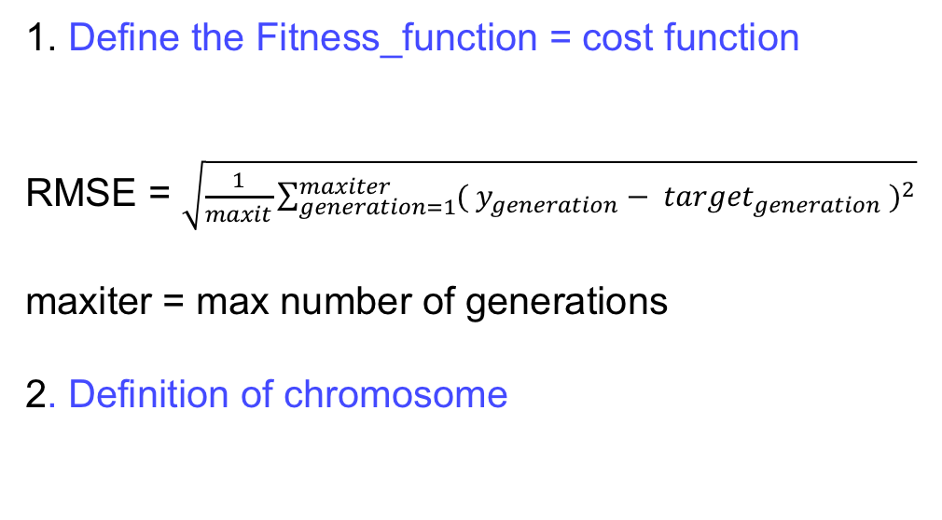
Training data is the input data for GA
1. Define the Fitness_function = cost function
RMSE = $\sqrt{\frac{1}{maxit}\sum_{generation=1}^{maxiter}{{( y_{generation}− {target}_{generation} )}^{2}}}$
maxiter = max number of generations
2. Definition of chromosome
Data for training

Slide 4
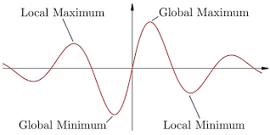
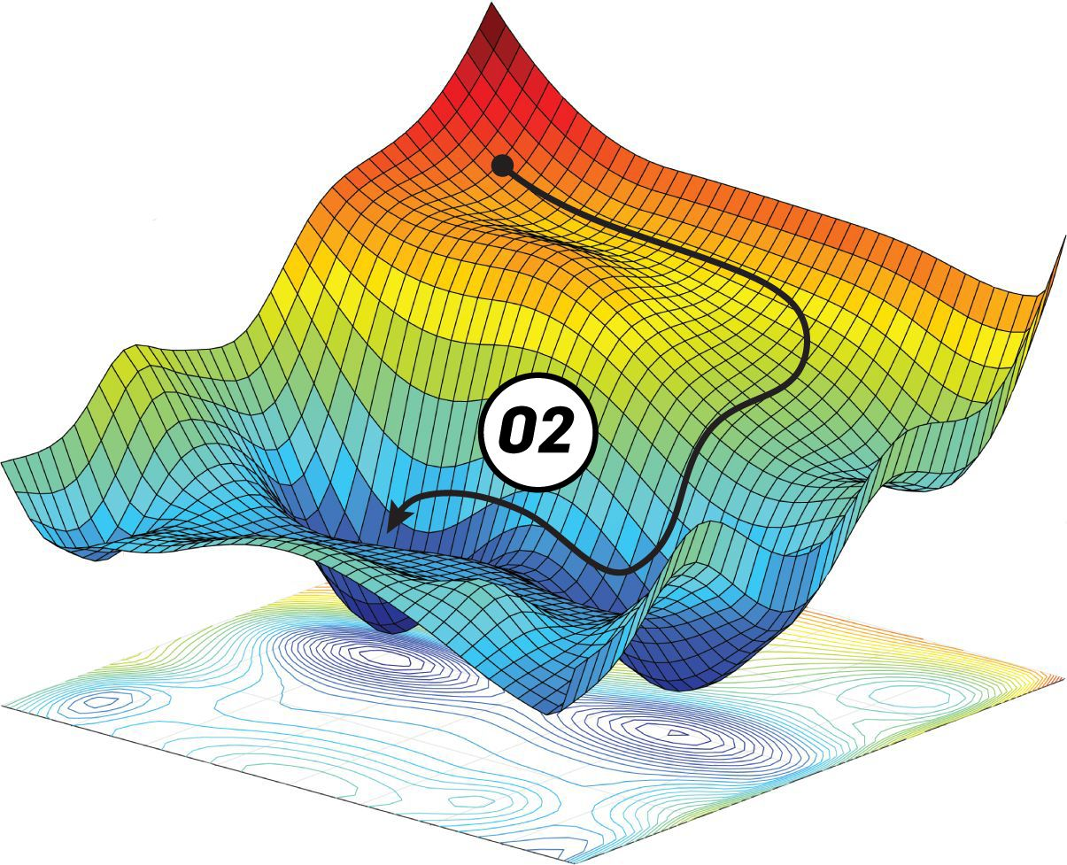
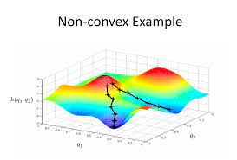
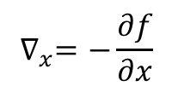
GRADIENT DESCENT APPROACH VS GENETIC ALGORITHMS
f(x)
$$∇_{x}=−\frac{∂f}{∂x}$$
GA AVOIDS GETTING TRAPPED IN A LOCAL MINIMUM
x
Non-Convex Function

Slide 6
p1
p2
p3
p4
p5
p6
p7
mother
father
Selection of parents
Pairing from top to bottom
Random Pairing
Weighted Random Pairing (also known) as roulette wheel
Rank weighting
Cost weighting

Slide 7
Selection used here
Roulette Wheel
All individuals have the same probability to become parents
p2
p3
p1
p4
p7
p5
p6

Slide 8
Selection used here
Roulette Wheel
All individuals have the same probability to become parents
p2
p3
p1
p4
p7
p5
p6

Slide 9
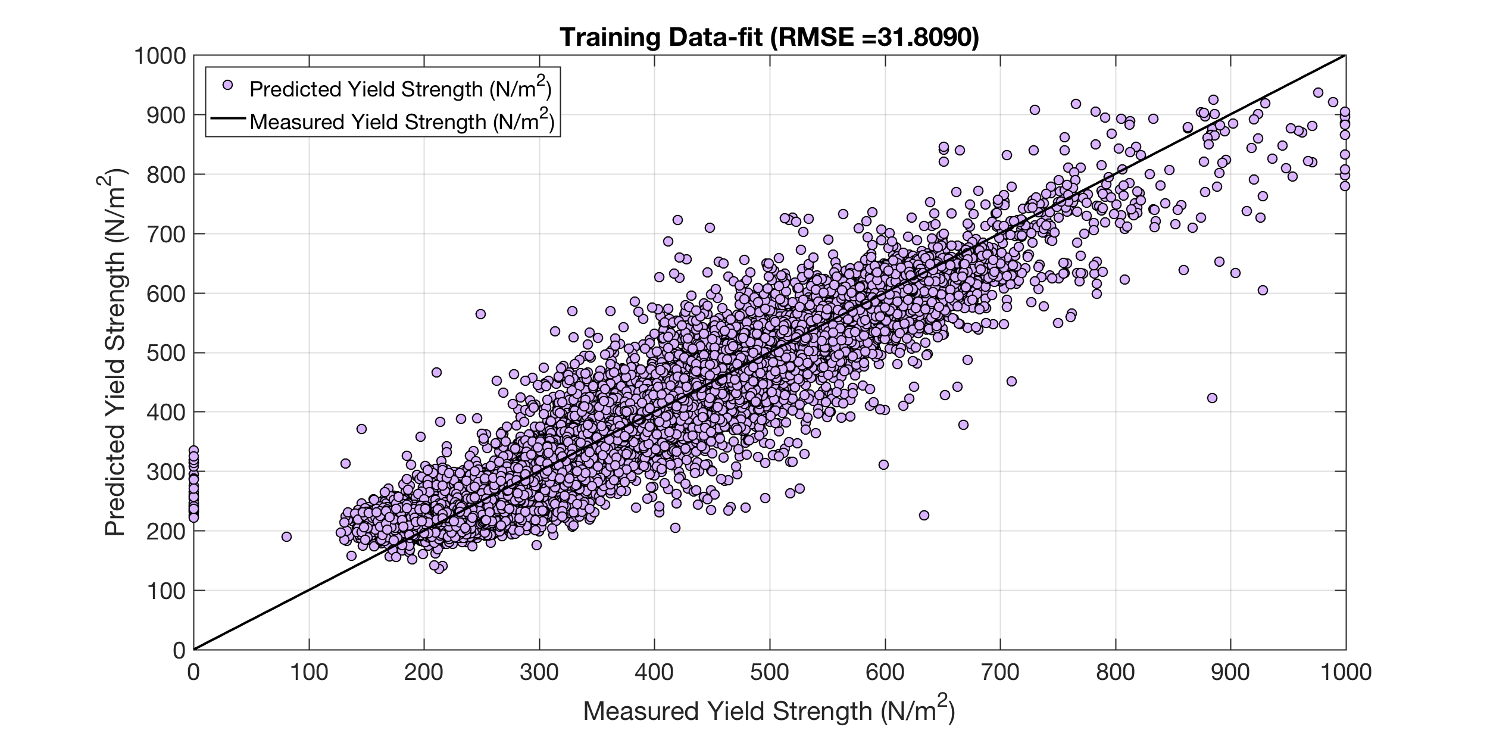
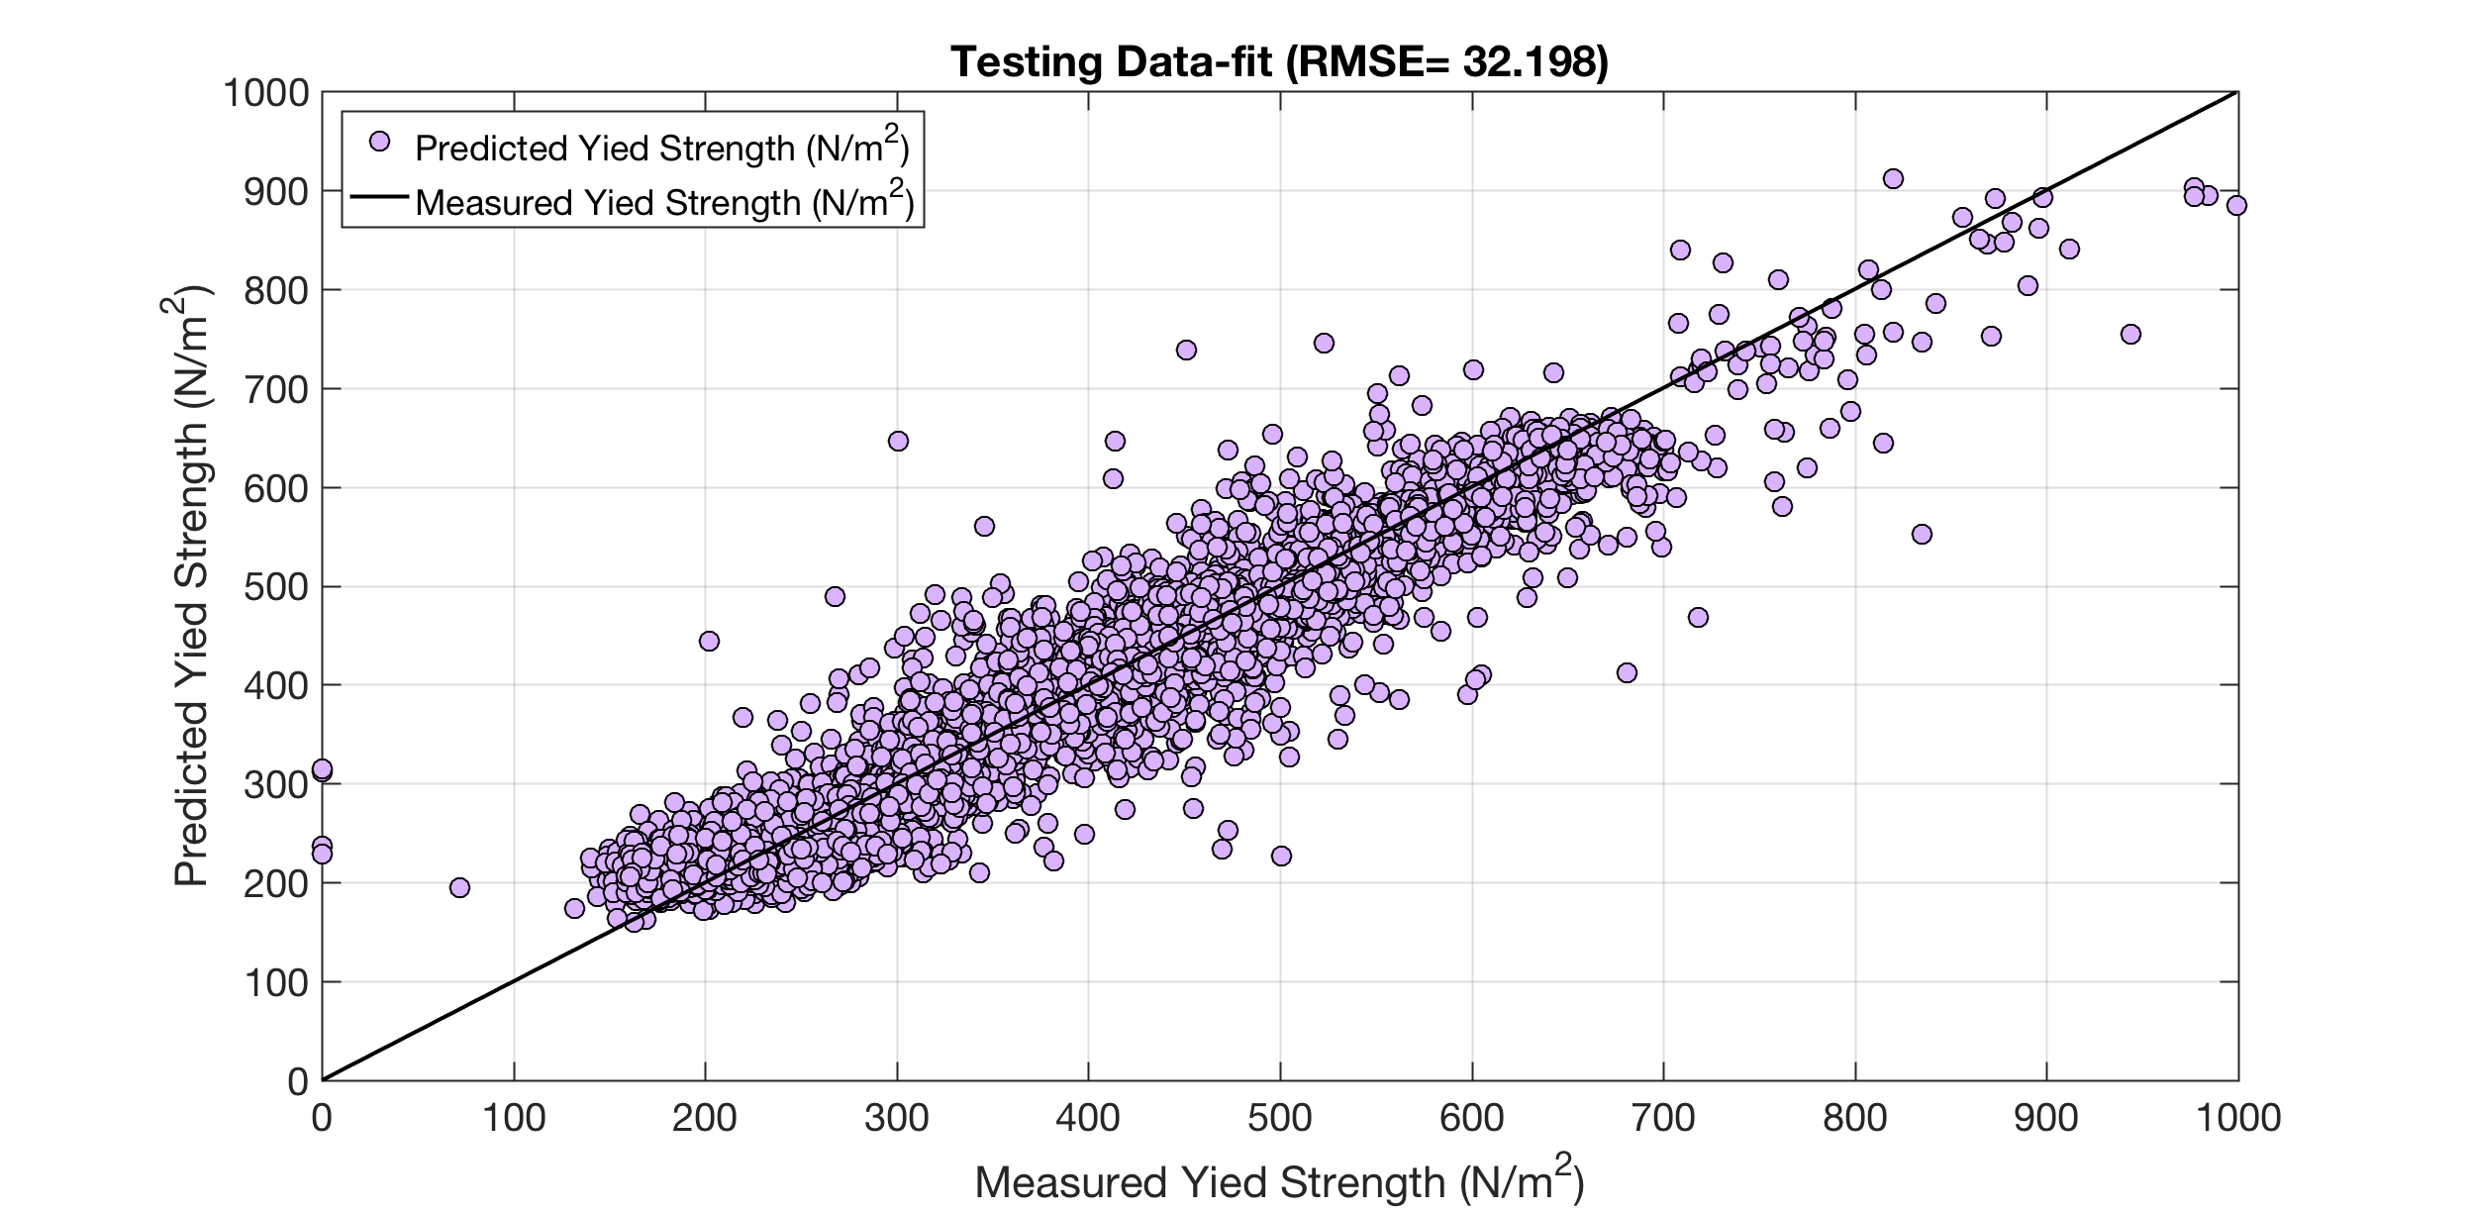
Evolutionary results

Slide 10
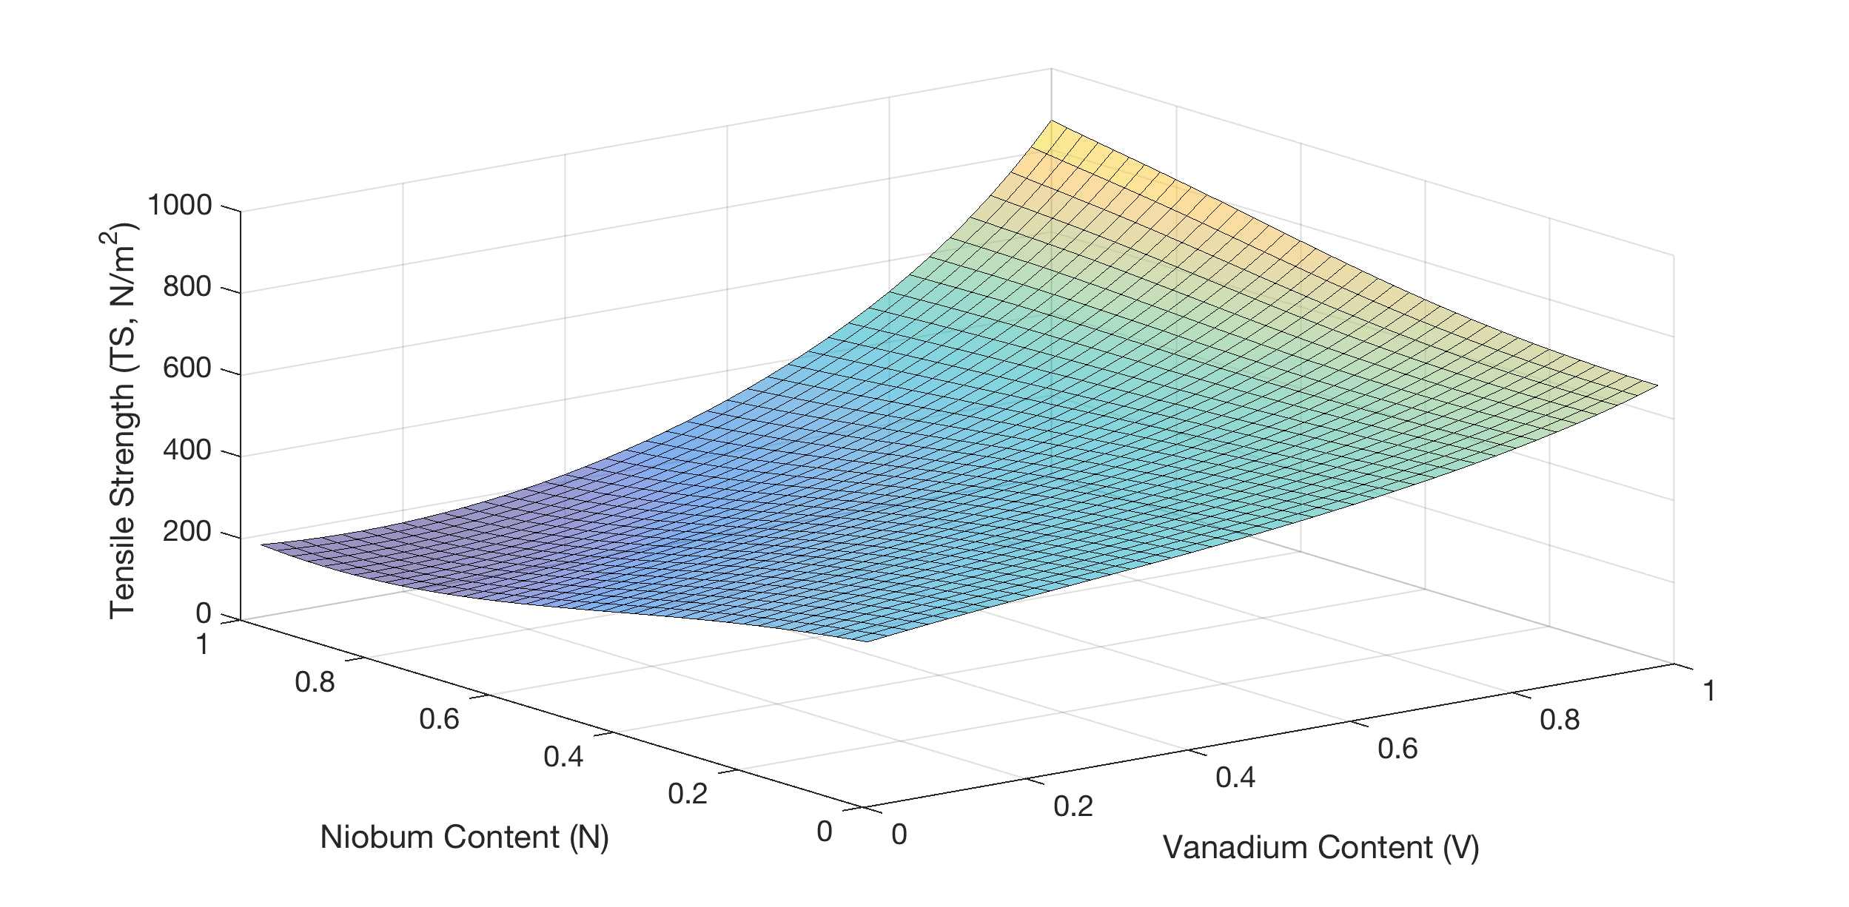
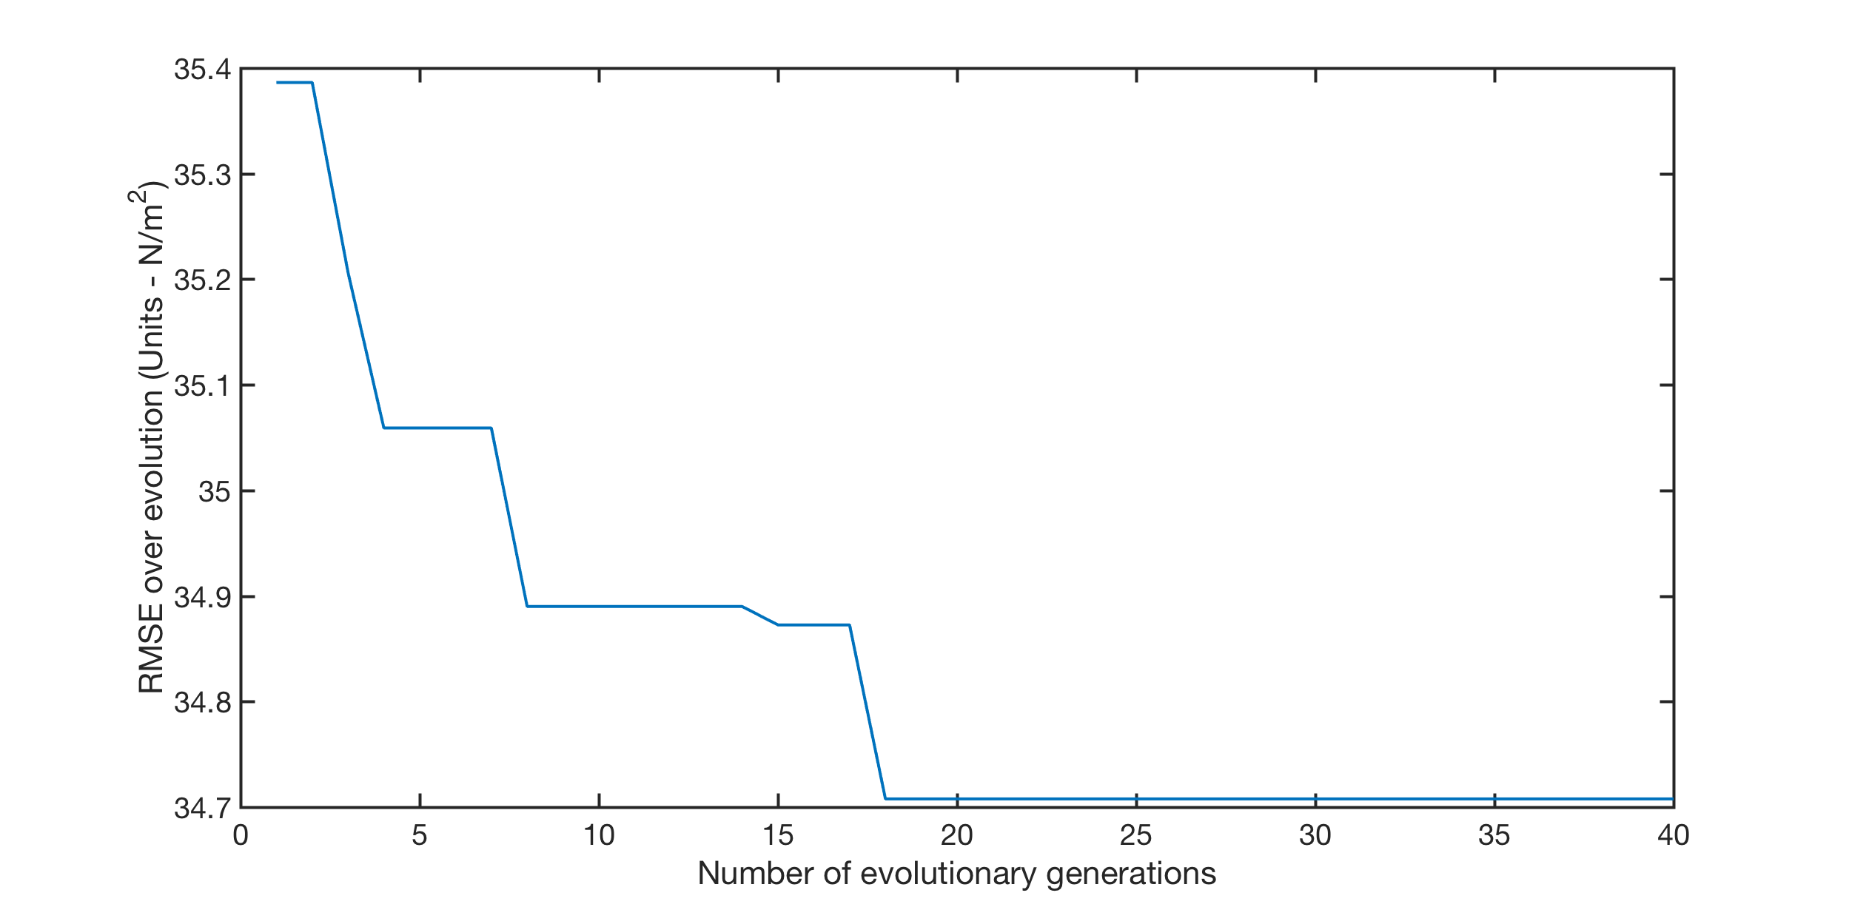

Slide 11
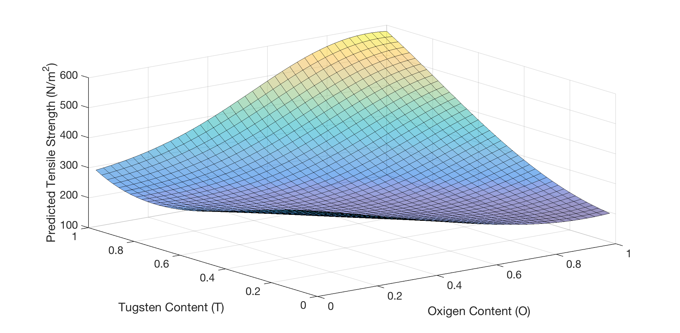

Slide 12
MUTATION
The number of mutations is given by:
p2
p3
p1
p4
p7
p5
p6

